Slide 1
Hierarchical clustering

Slide 2
Learning Objectives
Introduction to hierarchical clustering
Measuring distance between clusters
Complete linkage method
Hands on exercise on Hierarchical clustering
2

Slide 3
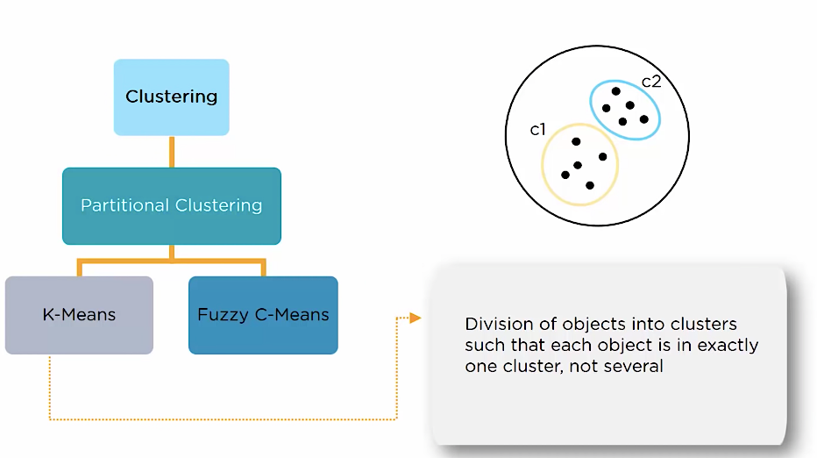
K Means Clustering

Slide 4
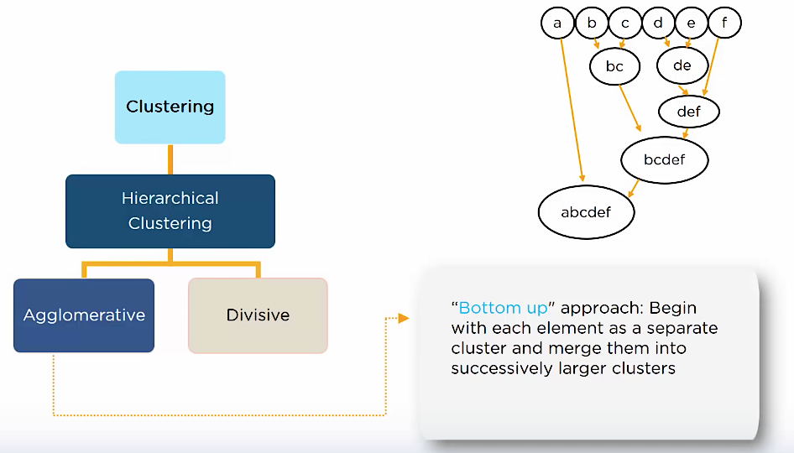
Hierarchical Clustering
Tree Like Structure or like Parent Child Relationship
Each Element is taken as separate cluster and merged into bigger clusters. This is Agglomerative Process

Slide 5
Hierarchical Clustering
Hierarchical Clustering is an Algorithm that builds Hierarchy of Clusters

Slide 6
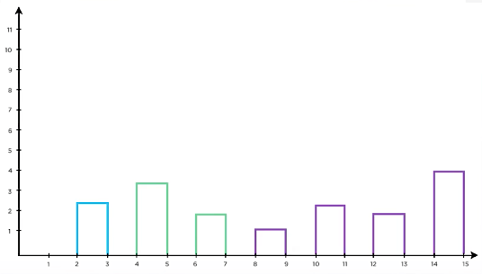
Agglomerative Clustering
Agglomerative Clustering is Bottom Up Approach

Slide 7
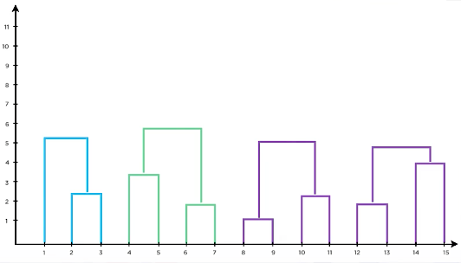
Agglomerative Clustering
Agglomerative Clustering is Bottom Up Approach

Slide 8
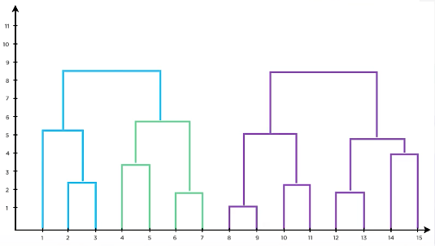
Agglomerative Clustering
Agglomerative Clustering is Bottom Up Approach

Slide 9
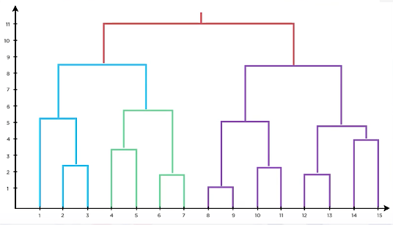
Agglomerative Clustering
Agglomerative Clustering is Bottom Up Approach

Slide 10
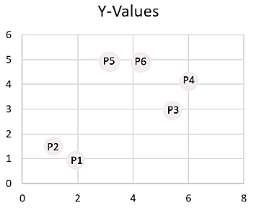
How Hierarchical Clustering Works
Measure the Distance
Lets Consider Few Points on a Plane
Figure out a way to compute distance between two points
Remember each data point is a cluster of its own.
We try and find out the least distance between two clusters

Slide 11
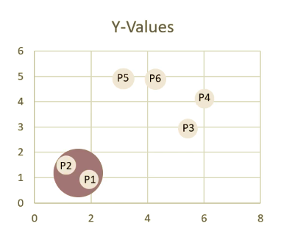
How Hierarchical Clustering Works
Grouping
The Two Nearest Data-points/Clusters are merged together.
This is represented in a Tree Structure called Denodrogram.

Slide 12
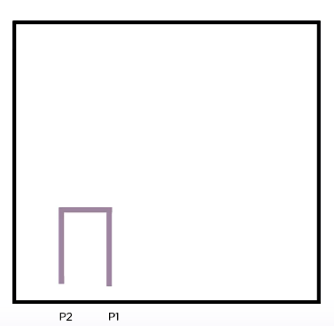
How Hierarchical Clustering Works
Grouping

Slide 13
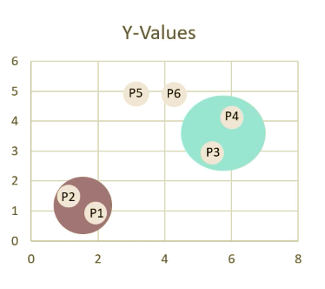
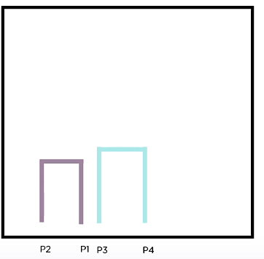
How Hierarchical Clustering Works
Grouping

Slide 14
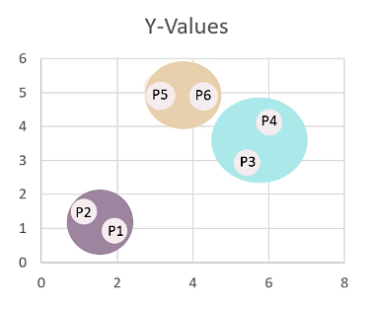
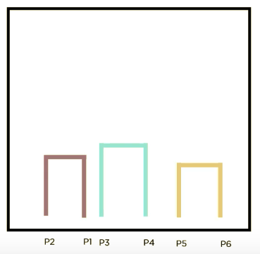
How Hierarchical Clustering Works
Grouping

Slide 15
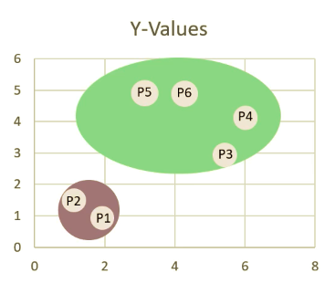
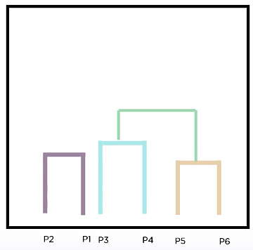
How Hierarchical Clustering Works
Grouping
We group two groups together, they would appear in one Dendrogram.

Slide 16
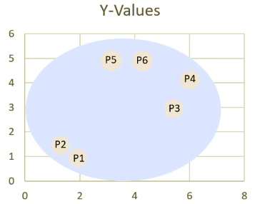
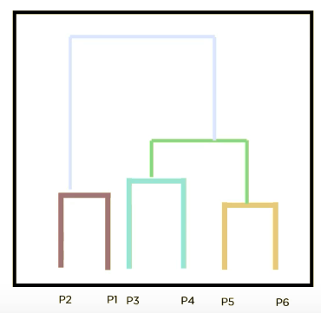
How Hierarchical Clustering Works
Termination
We Terminate when we are left with one cluster

Slide 17
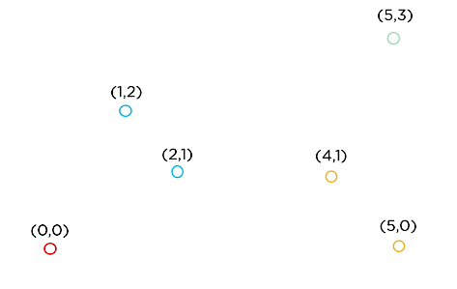

What is Agglomerative Clustering
Agglomerative Clustering begins with each element as a separate cluster and merge them into larger clusters.
Lets assume we have 06 Data-Points in Euclidean Space.

Slide 18
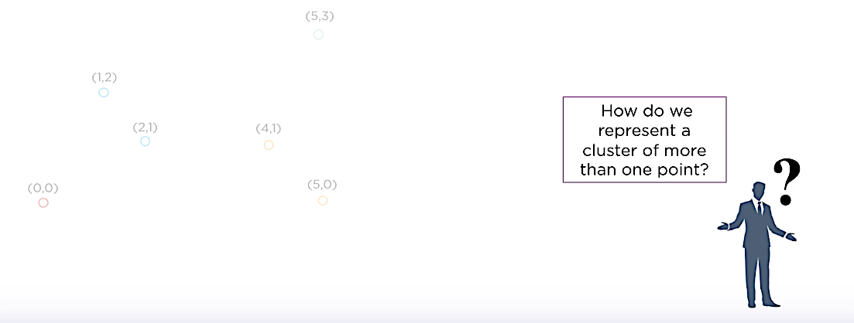
What is Agglomerative Clustering
Agglomerative Clustering begins with each element as a separate cluster and merge them into larger clusters.

Slide 19
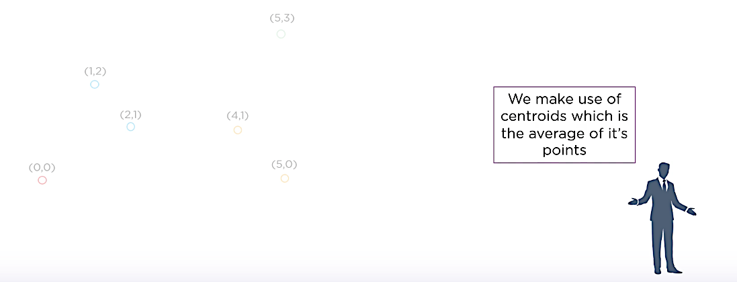
What is Agglomerative Clustering
Agglomerative Clustering begins with each element as a separate cluster and merge them into larger clusters.

Slide 20
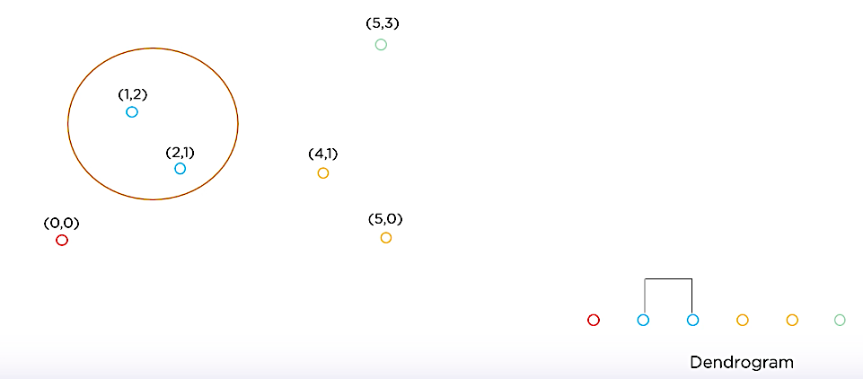
What is Agglomerative Clustering
Lets Calculate the Centroid of Two Points and Group them as One..

Slide 21
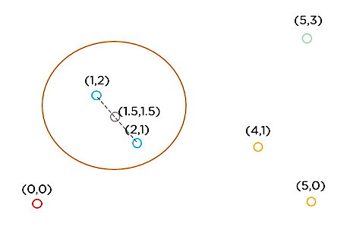
What is Agglomerative Clustering
Here (1.5,1.5) is the centroid of those two points.

Slide 22
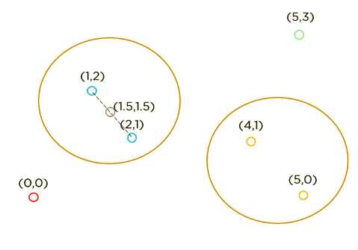

What is Agglomerative Clustering
Next we start measuring the distance of other two points and find the centroid.

Slide 23
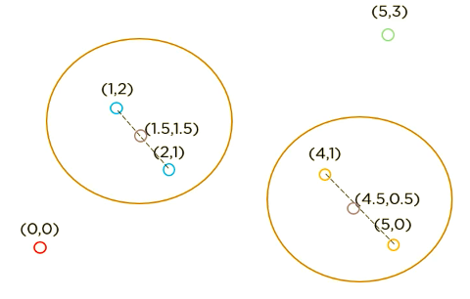
What is Agglomerative Clustering
Next we start measuring the distance of other two points and find the centroid.

Slide 24
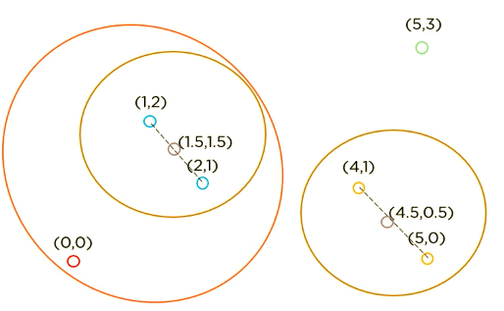
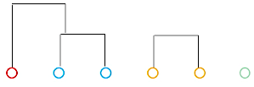
What is Agglomerative Clustering
Once we group these, we would then find out the closest distance of another point

Slide 25
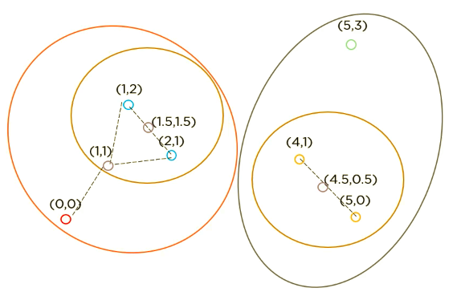
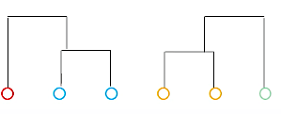
What is Agglomerative Clustering
Once we group these, we would then find out the closest distance of another point

Slide 26
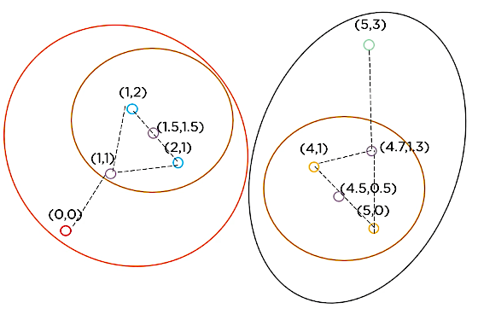
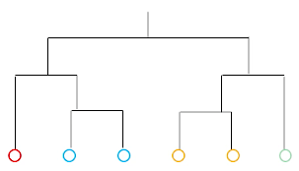
What is Agglomerative Clustering
Finally all the points converge into one Big Dendrogram

Slide 27
Summarizing Everything…
It starts by calculating the distance between every pair of observation points and store it in a distance matrix.
It then puts every point in its own cluster.
Then it starts merging the closest pairs of points based on the distances from the distance matrix and as a result the amount of clusters goes down by 1.
Then it recomputes the distance between the new cluster and the old ones and stores them in a new distance matrix.
Lastly it repeats steps 2 and 3 until all the clusters are merged into one single cluster.

Slide 28
Linkage Methods

Slide 29
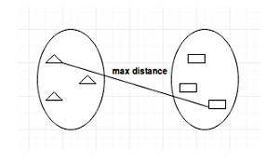
Linkage Methods | Complete Linkage
There are several ways to measure the distance between clusters in order to decide the rules for clustering and they are often called Linkage Methods. Some of the common linkage methods are:
Complete-linkage: calculates the maximum distance between clusters before merging

Slide 30
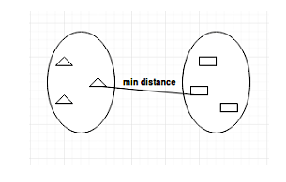
Linkage Methods | Single Linkage
There are several ways to measure the distance between clusters in order to decide the rules for clustering and they are often called Linkage Methods. Some of the common linkage methods are:
Single-linkage: calculates the minimum distance between the clusters before merging. This linkage may be used to detect high values in your dataset which may be outliers as they will be merged at the end.

Slide 31
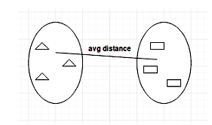
Linkage Methods | Average Linkage
There are several ways to measure the distance between clusters in order to decide the rules for clustering and they are often called Linkage Methods. Some of the common linkage methods are:
Average-linkage: calculates the average distance between the clusters before merging.

Slide 32
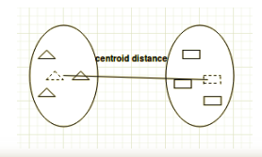
Linkage Methods | Centroid Linkage
There are several ways to measure the distance between clusters in order to decide the rules for clustering and they are often called Linkage Methods. Some of the common linkage methods are:
Centroid-linkage: Finds Centroid of Cluster1 and Centroid of Cluster 2, then calculates the distance between the two before merging.
The choice of linkage method entirely depends on you and there is no hard and fast method that will always give you good results.
Different linkage methods lead to different clusters.

Slide 33
Introduction to Hierarchical clustering
Hierarchical/Agglomerative clustering starts with each cluster comprising exactly one data point in the feature space.
It progressively combines the two nearest clusters until there is one grand cluster left in the feature space.
Complete and average linkage are better choice if the clusters are likely to be spherical.
For the closest cluster analysis, each of the inter cluster distance measurement techniques(single link, average link, etc) can be implemented

Slide 34
Measuring distance between clusters
Ideally, a good clustering should result in compact clusters separated from one another by maximal distance. This calls for measuring the distance between clusters. The most widely used methods are:
Minimum distance (single linkage)
Maximum distance (complete linkage)
Average distance (average linkage)
Centroid distance
Ward’s method

Slide 35
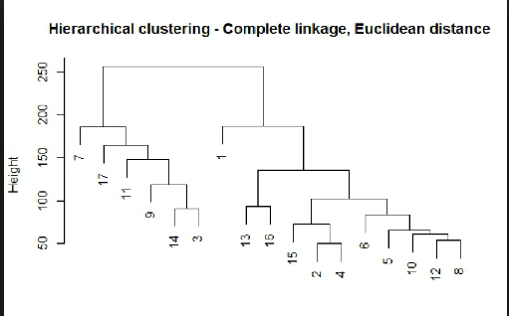
Complete linkage method
Complete linkage method is the largest distance between the pair of records Aj and Bj that belong to cluster A and B respectively.

Slide 36
Hands on exercise on Hierarchical clustering
Analyse the wines data set using agglomerative clustering
Some important functions
Importing packages
import pandas as pd
import numpy as np
import matplotlib.pyplot as plt
from scipy.stats import zscore
from sklearn.cluster import AgglomerativeClustering

Slide 37
2. Build model
model = AgglomerativeClustering(n_clusters=6, affinity='euclidean', linkage='average')
model.fit(wine_data_attr)
AgglomerativeClustering(affinity='euclidean', compute_full_tree='auto', connectivity=None, linkage='average', memory=None, n_clusters=6, pooling_func=<function mean at 0x000002BC32915048>)
wine_groups=wine_clusters.head(1599) #This creates a pandas data frame group by object
from scipy.spatial.distance import pdist #Pairwise distribution between data points
Z = linkage(wine_data_attr, 'average')
c, coph_dists = cophenet(Z , pdist(wine_data_attr))

Slide 38


Questions?

